Slide 1
I WILL GO
IN THE BOOK OF ACTS
Anthony Kent (kenta@gc.adventist.org)

Slide 2
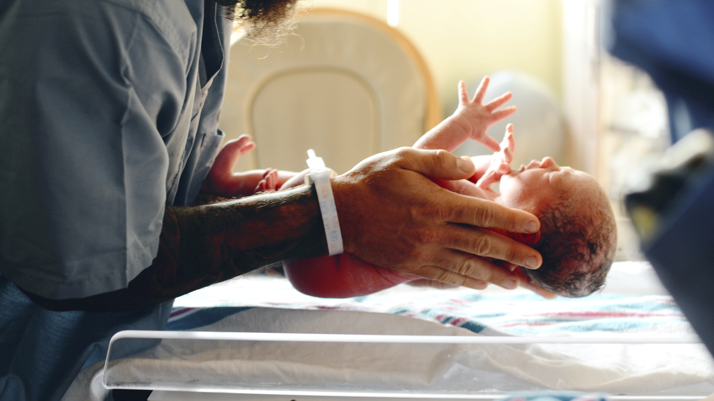

Slide 8
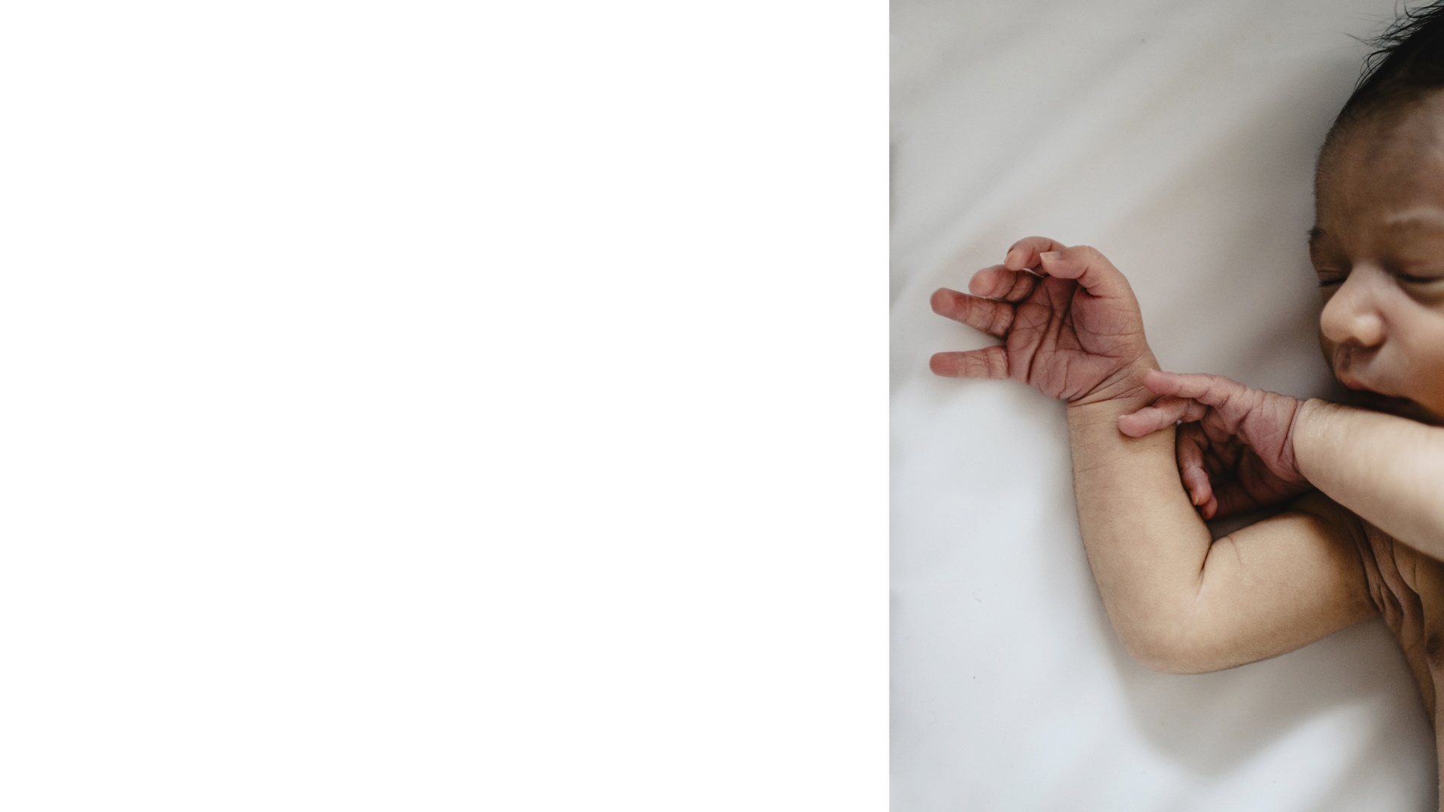
Every year seven times our current membership is born.
Most will be born in circumstances ambivalent or hostile to Christianity.
Most will be exploited
Unaware that God’s love is free and never-ending

Slide 9
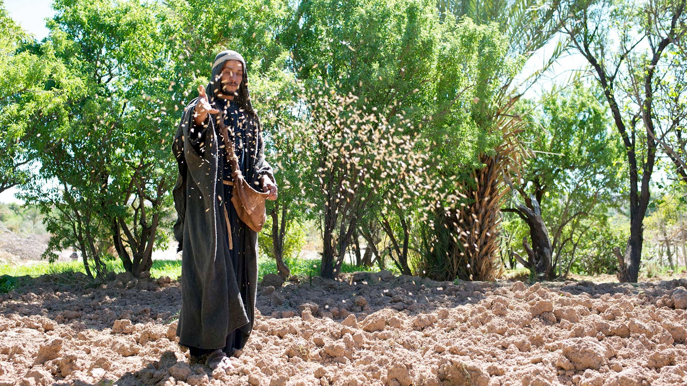
And when a great crowd was gathering and people from town after town came to him, he said in a parable, “A sower went out to sow his seed.

Slide 10
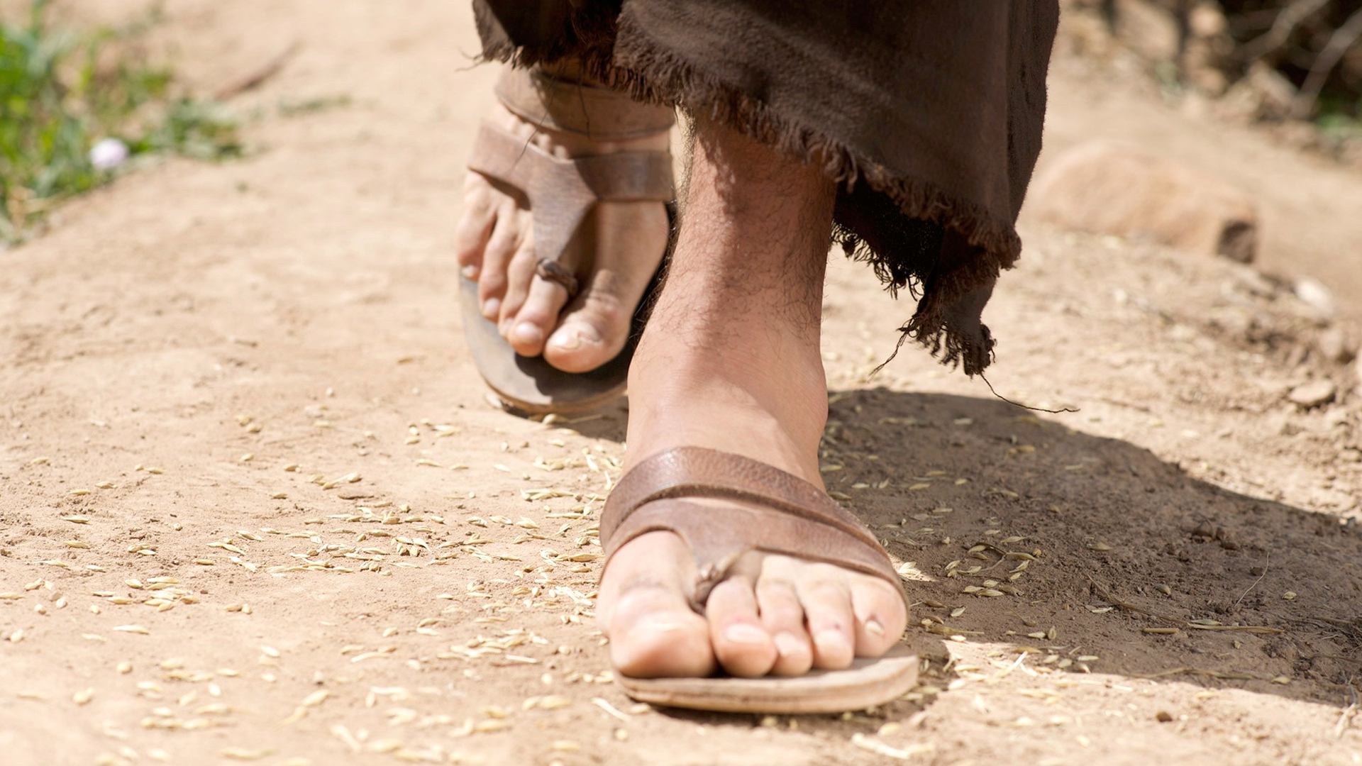
And as he sowed, some fell along the path and was trampled underfoot, and the birds of the air devoured it.

Slide 11
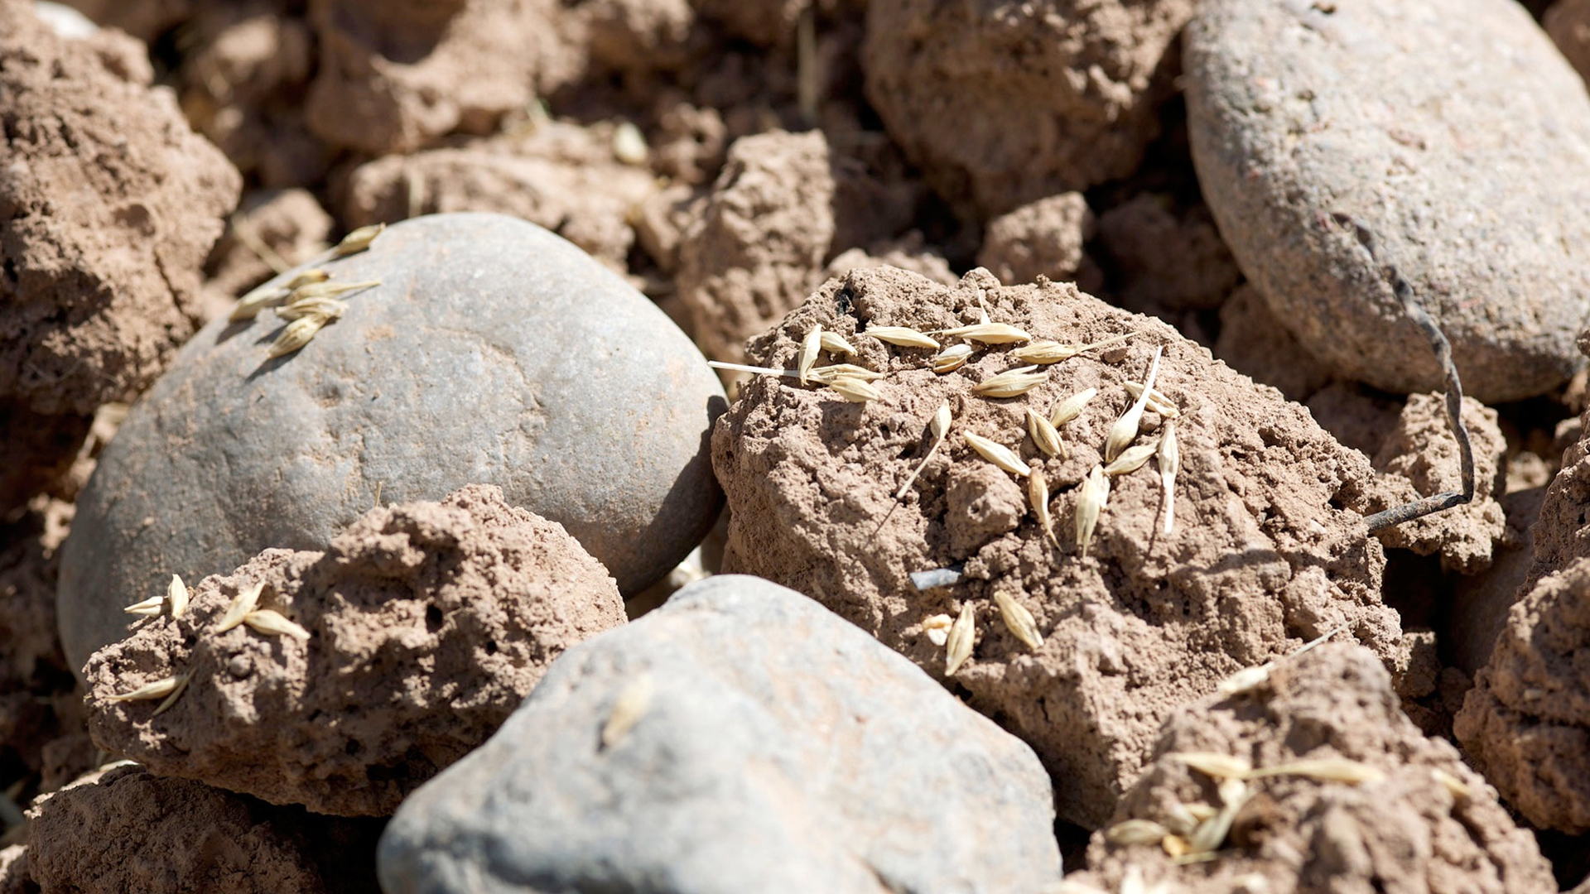
And some fell on the rock, and as it grew up, it withered away, because it had no moisture.

Slide 12
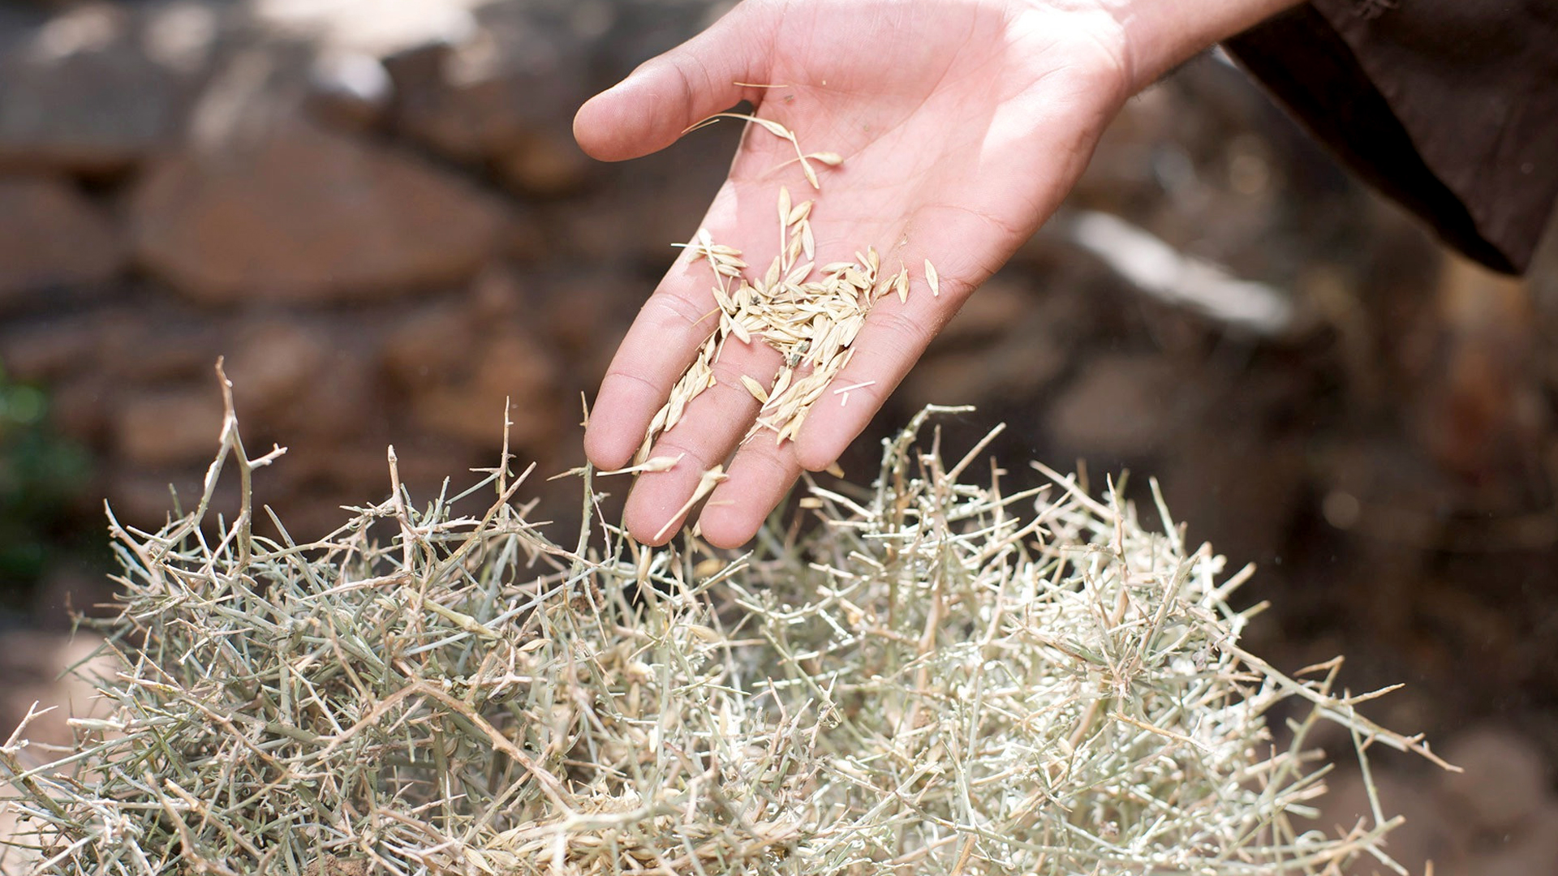
And some fell among thorns, and the thorns grew up with it and choked it.

Slide 13
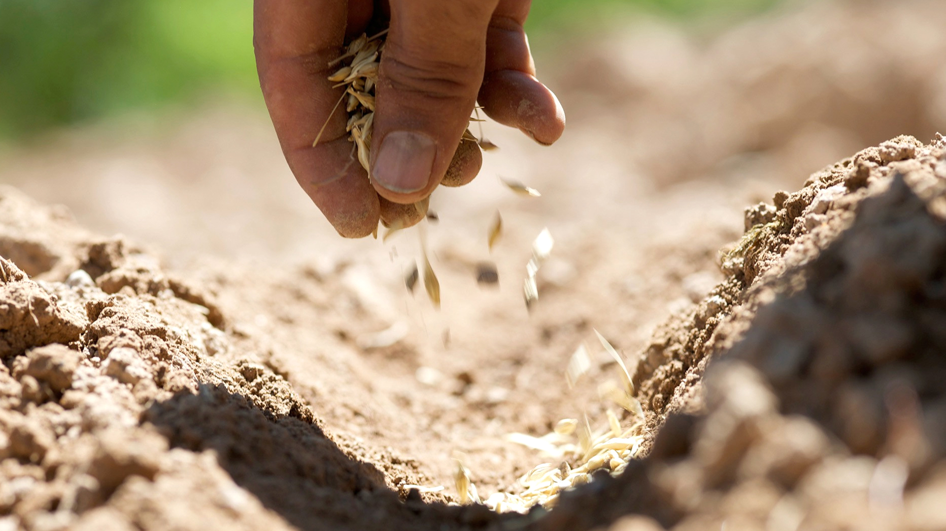
And some fell into good soil and grew and yielded a hundredfold.”

Slide 14
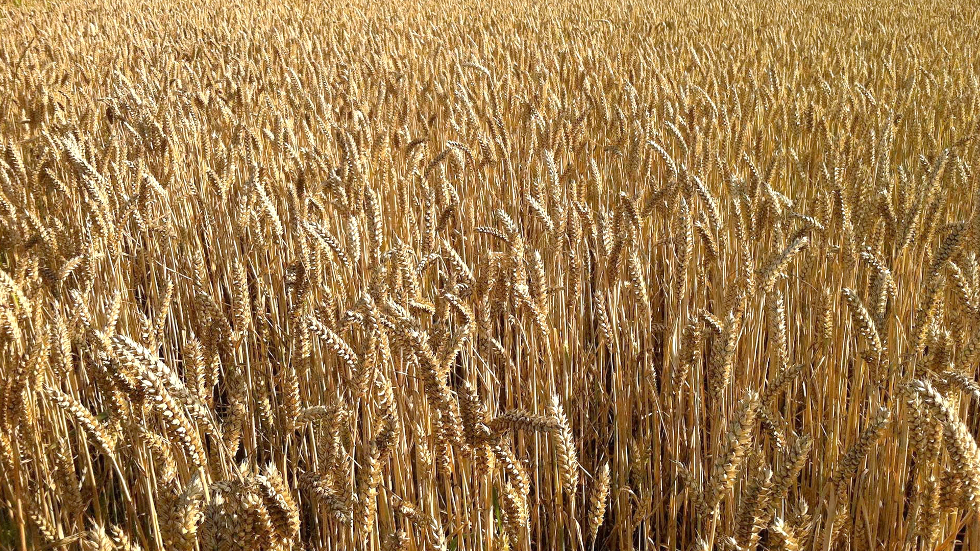
As he said these things, he called out, “He who has ears to hear, let him hear.” Luke 8:4-15, ESV

Slide 15
And when his disciples asked him what this parable meant, he said, “To you it has been given to know the secrets of the kingdom of God, but for others they are in parables, so that ‘seeing they may not see, and hearing they may not understand.’ Now the parable is this: The seed is the word of God. The ones along the path are those who have heard; then the devil comes and takes away the word from their hearts, so that they may not believe and be saved.

Slide 16
And the ones on the rock are those who, when they hear the word, receive it with joy. But these have no root; they believe for a while, and in time of testing fall away. And as for what fell among the thorns, they are those who hear, but as they go on their way they are choked by the cares and riches and pleasures of life, and their fruit does not mature. As for that in the good soil, they are those who, hearing the word, hold it fast in an honest and good heart, and bear fruit with patience. Luke 8:4-15, ESV

Slide 17
For the wages of sin is death, but the free gift of God is eternal life in Christ Jesus our Lord. Romans 6:23, ESV

Slide 18
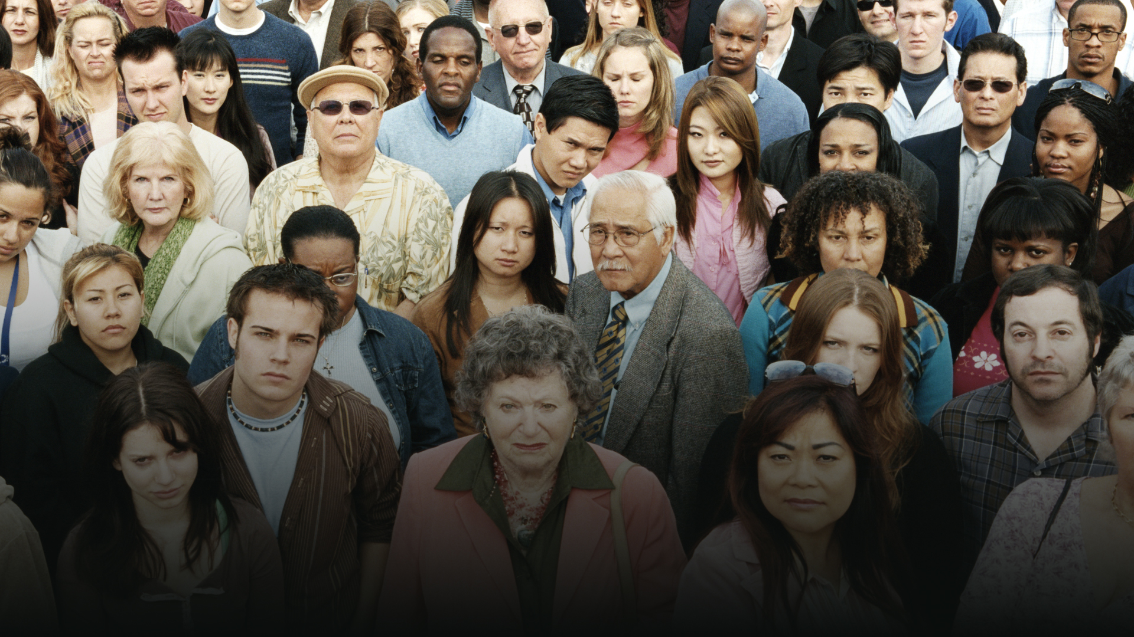
For “everyone who calls on the name of the Lord will be saved.” How then will they call on him in whom they have not believed? And how are they to believe in him of whom they have never heard? And how are they to hear without someone preaching? And how are they to preach unless they are sent? As it is written, “How beautiful are the feet of those who preach the good news!” Romans 10:13-15, ESV

Slide 19
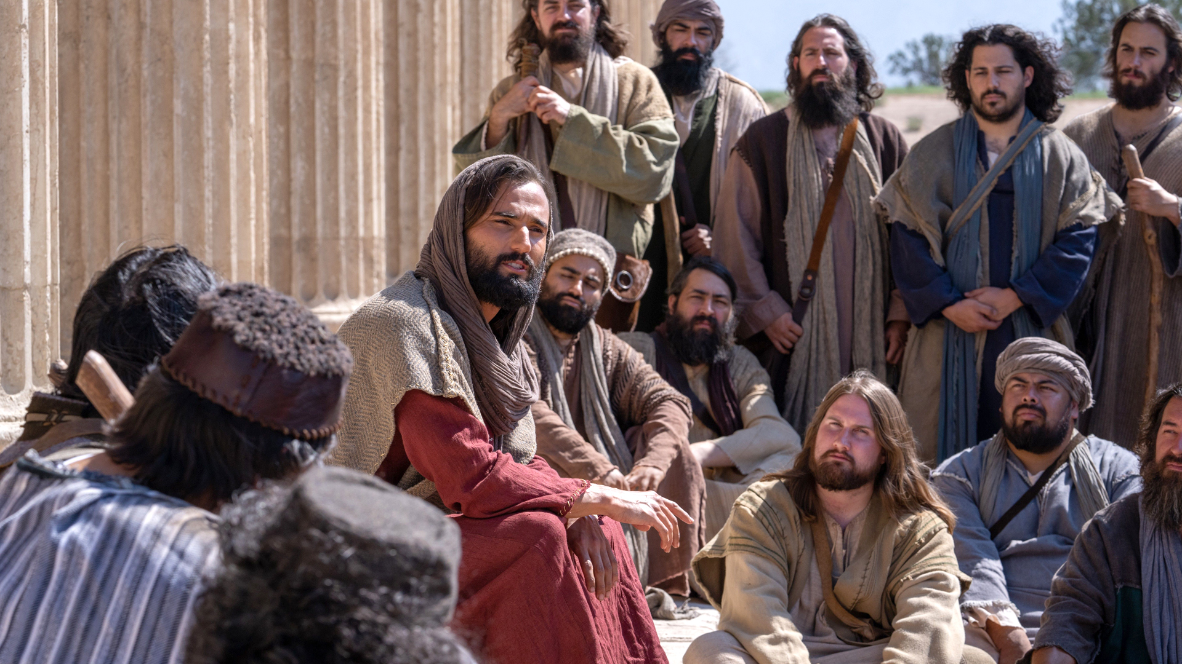
Their Jewish brothers and sisters opposed them.
Rome was ruthless towards anything resembling a rival to Caesar or Roman authority.
Travel was slow, dangerous, and laborious.
Communication was limited.
Short life-expectancy

Slide 20
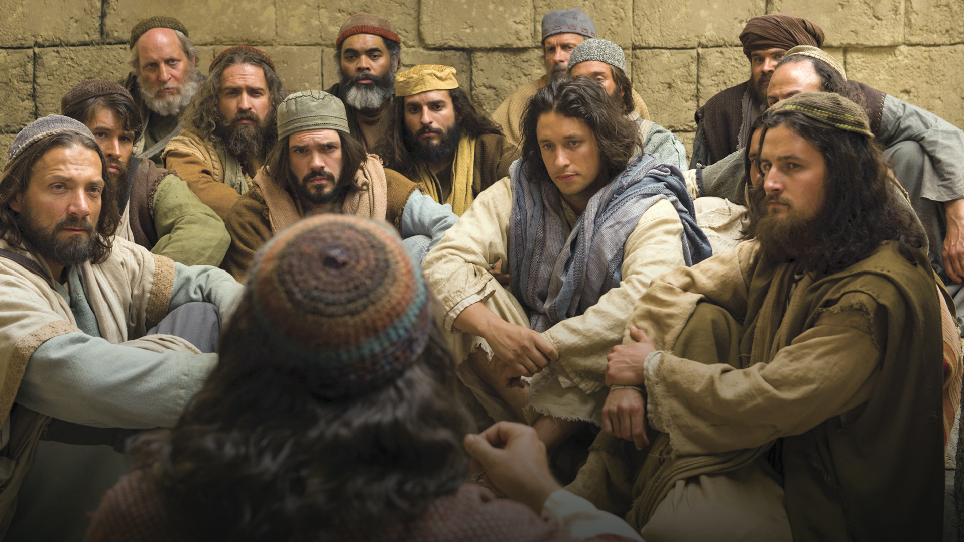
WHAT DID THEY HAVE?

Slide 21
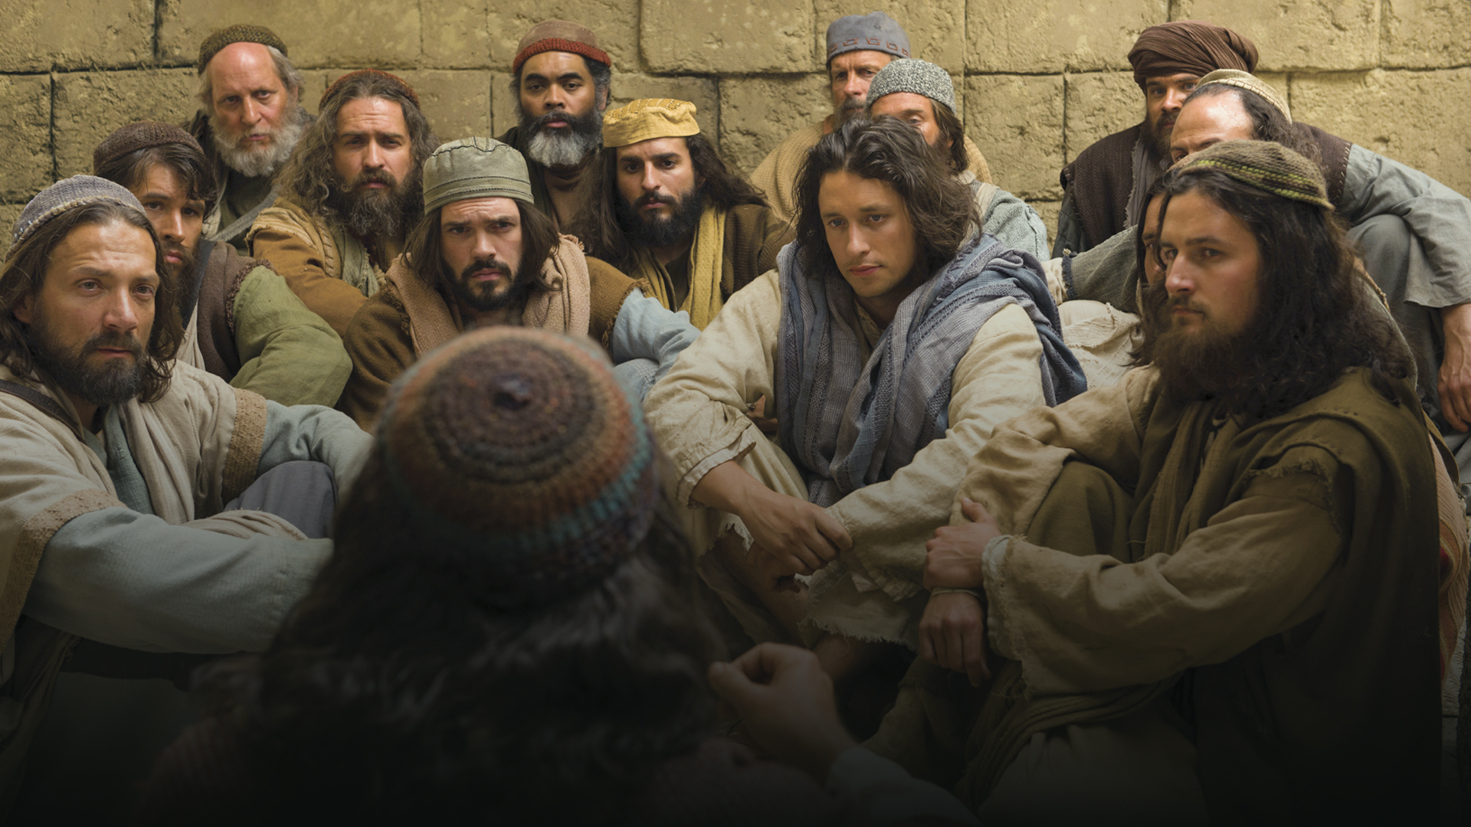
They had the assurance of a commission by Jesus Himself.

Slide 22
They had the assurance of a commission by Jesus Himself.
And Jesus came and said to them, “All authority in heaven and on earth has been given to me. Go therefore and make disciples of all nations, baptizing them in the name of the Father and of the Son and of the Holy Spirit, teaching them to observe all that I have commanded you. And behold, I am with you always, to the end of the age.”
Matthew 28:19-20, ESV

Slide 23
They were promised the Holy Spirit.

Slide 24
They were promised the Holy Spirit.
But you will receive power when the Holy Spirit has come upon you, and you will be my witnesses in Jerusalem and in all Judea and Samaria, and to the end of the earth. Acts 1:8, ESV

Slide 25
They were given the Holy Spirit.

Slide 26
They were given the Holy Spirit.
And suddenly there came from heaven a sound like a mighty rushing wind, and it filled the entire house where they were sitting. And divided tongues as of fire appeared to them and rested on each one of them. And they were all filled with the Holy Spirit and began to speak in other tongues as the Spirit gave them utterance. Acts 2:2-4, ESV

Slide 27
The Holy Spirit was poured out on Gentiles!

Slide 28
The Holy Spirit was poured out on Gentiles!
And the believers from among the circumcised who had come with Peter were amazed, because the gift of the Holy Spirit was poured out even on the Gentiles. Acts 10:45, ESV

Slide 29
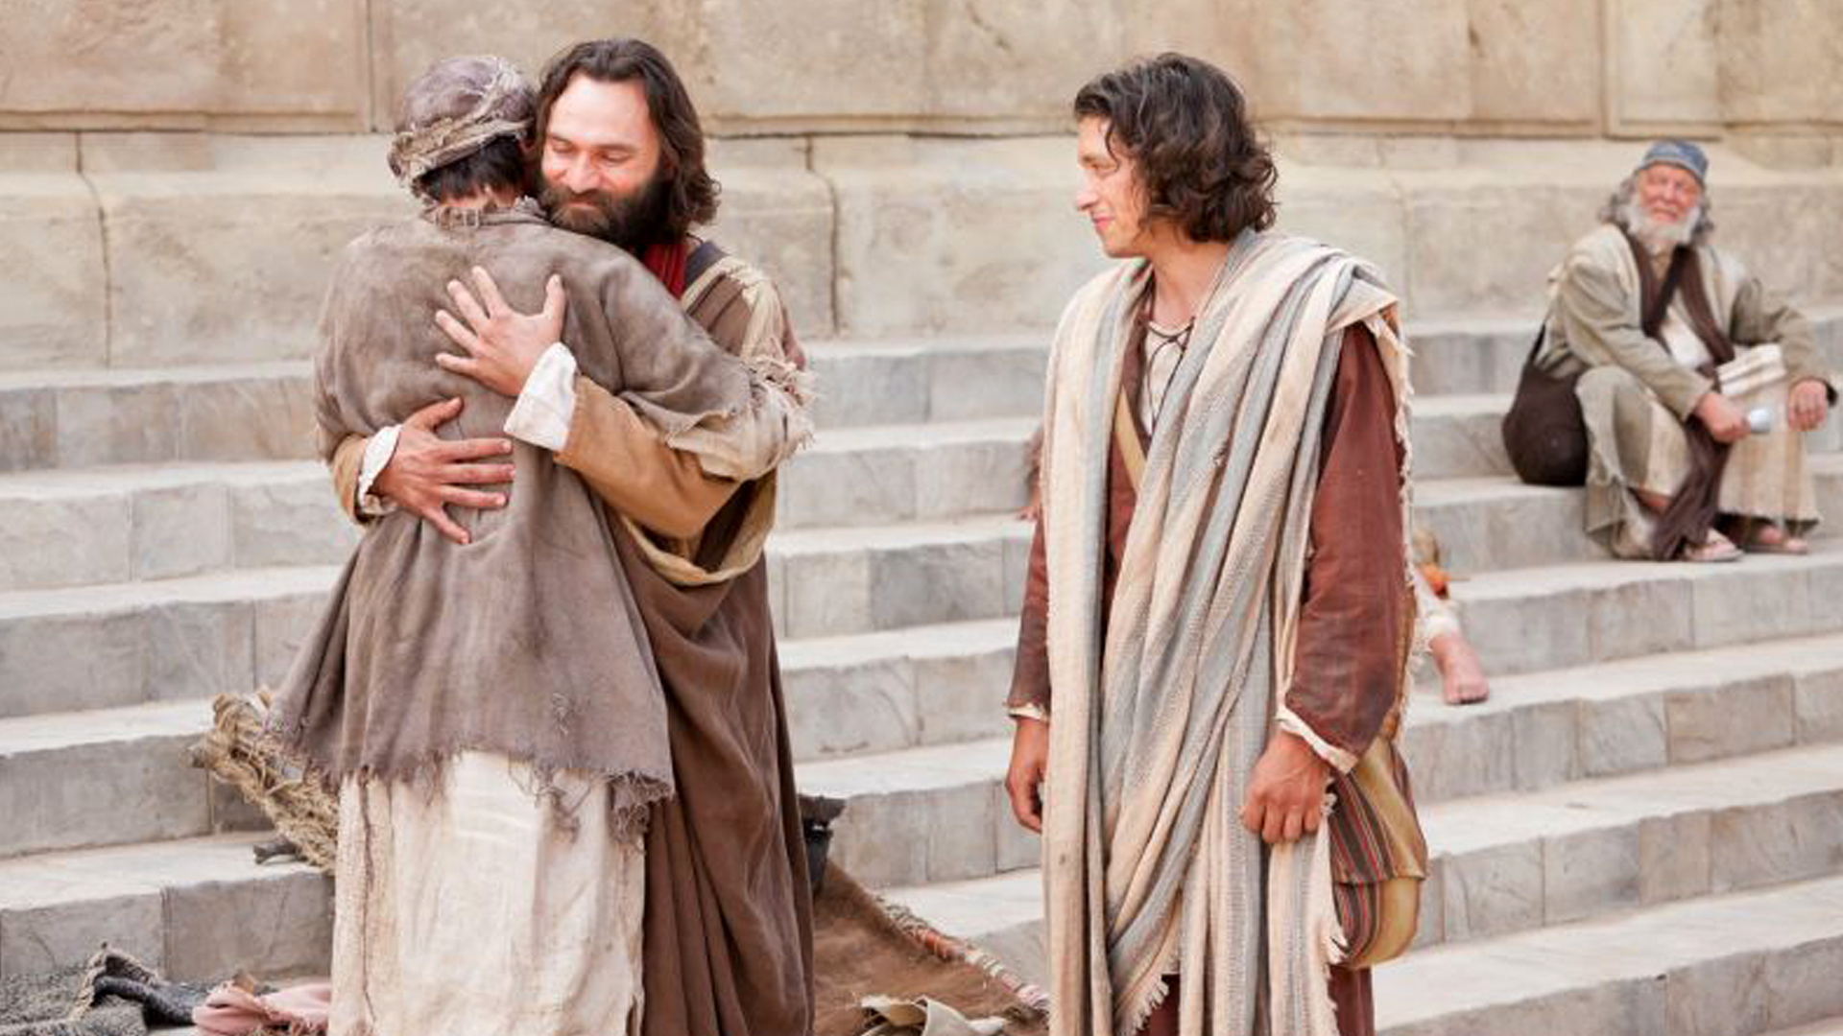
If you then, who are evil, know how to give good gifts to your children, how much more will the heavenly Father give the Holy Spirit to those who ask him! Luke 11:13, ESV

Slide 30
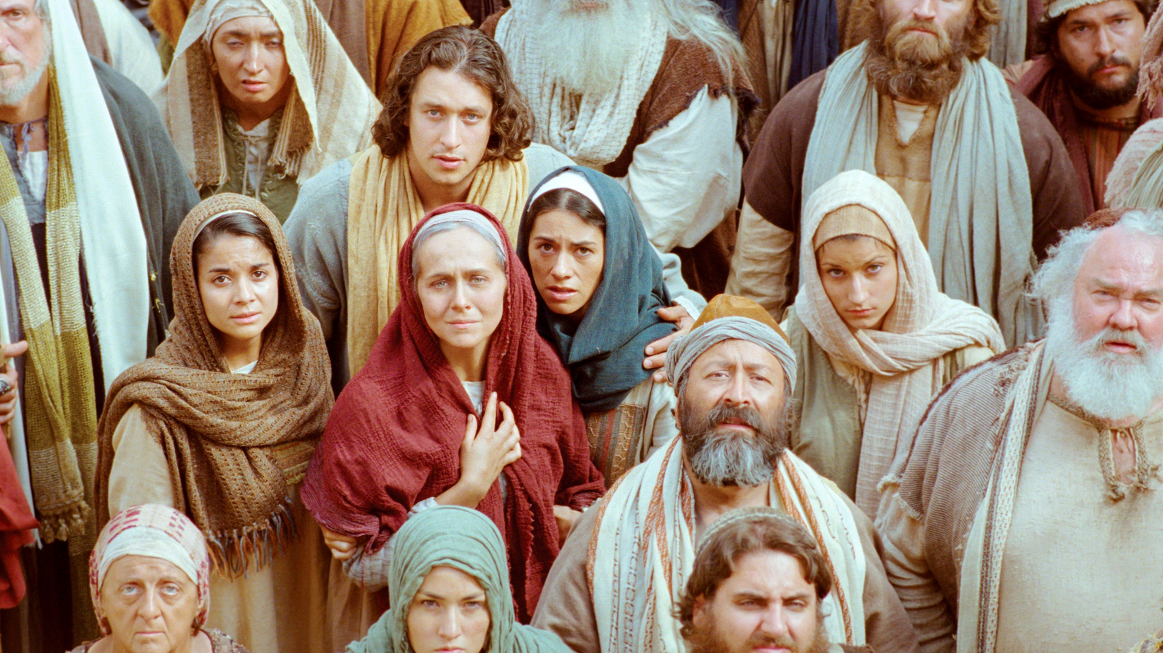

Slide 31
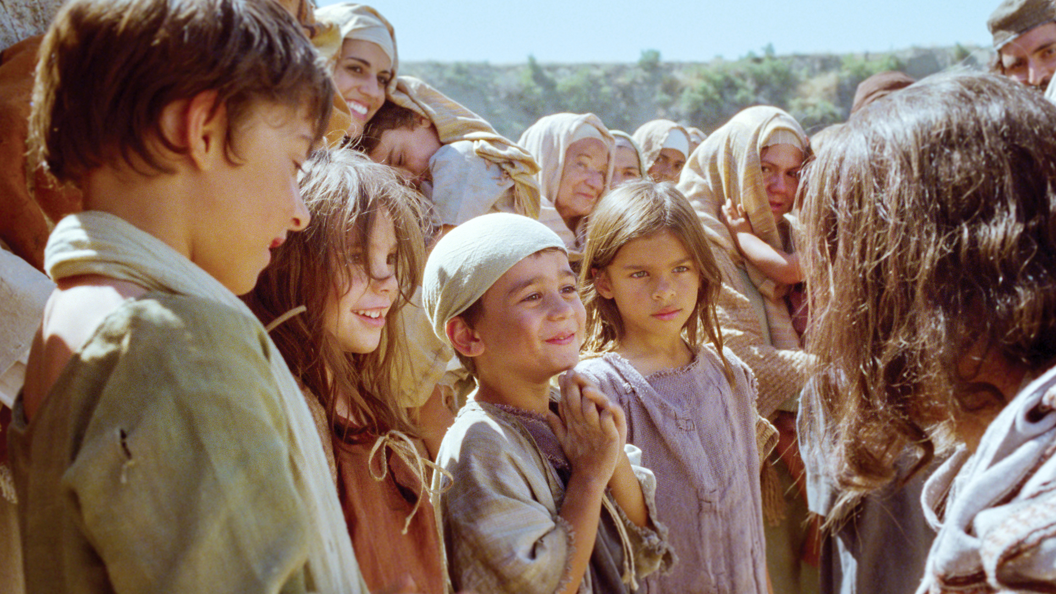

Slide 32
Barnabas

Slide 33
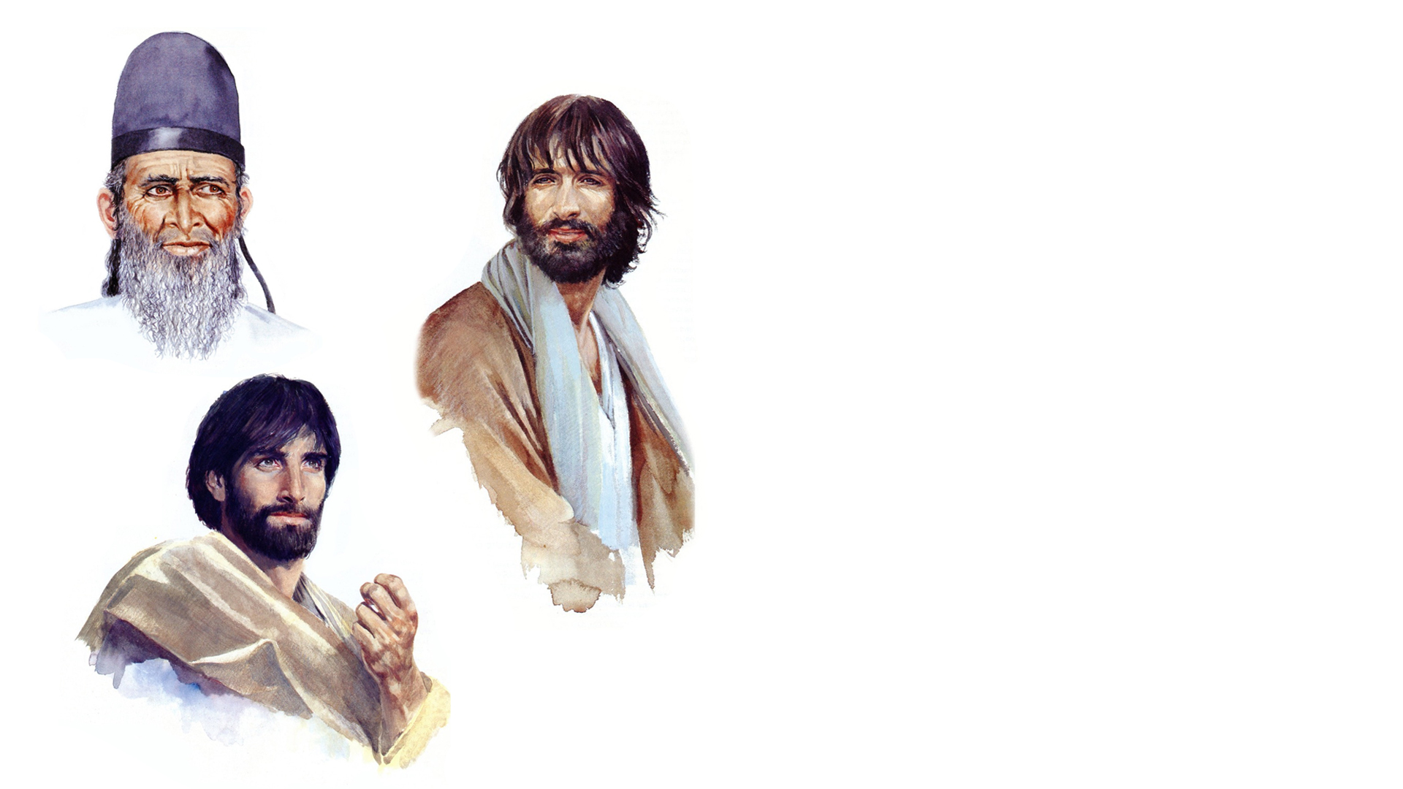
Barnabas
Philip
Stephen

Slide 34
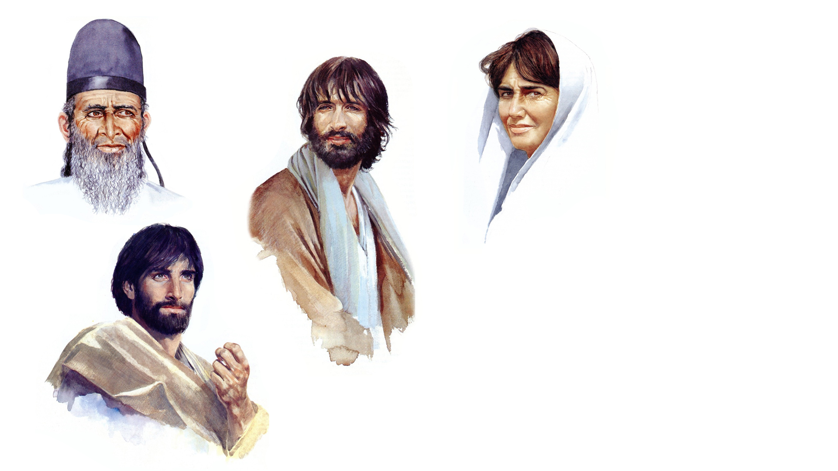
Barnabas
Dorcas
Philip
Stephen

Slide 35
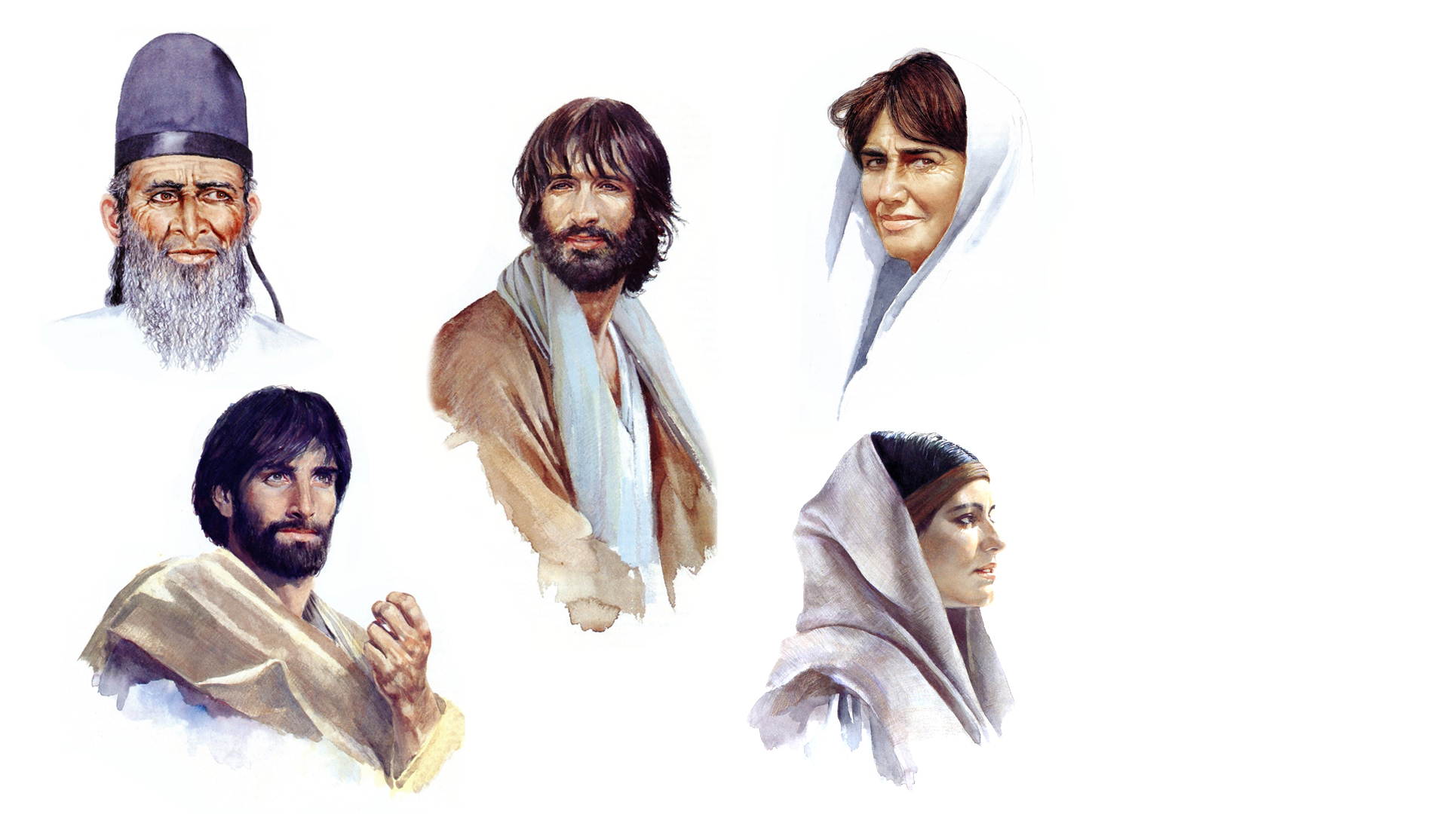
Barnabas
Dorcas
Philip
Stephen
Rhoda

Slide 36
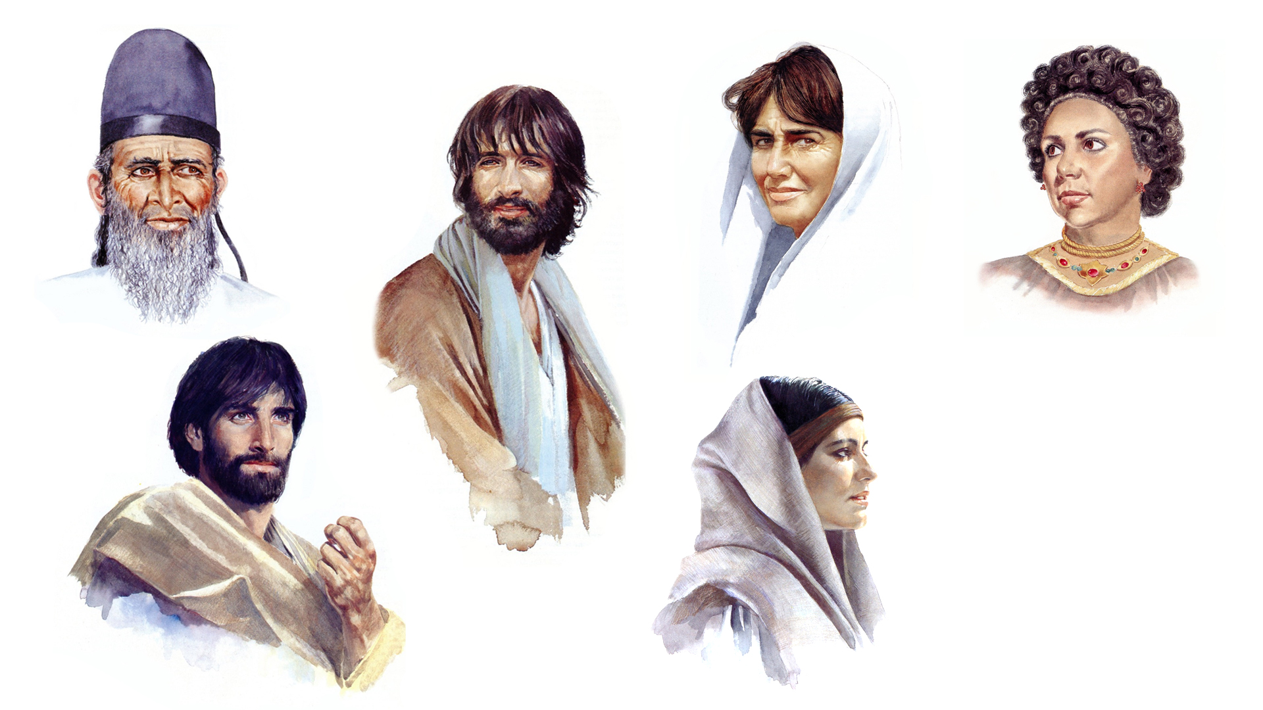
Barnabas
Dorcas
Philip
Lydia
Stephen
Rhoda

Slide 37
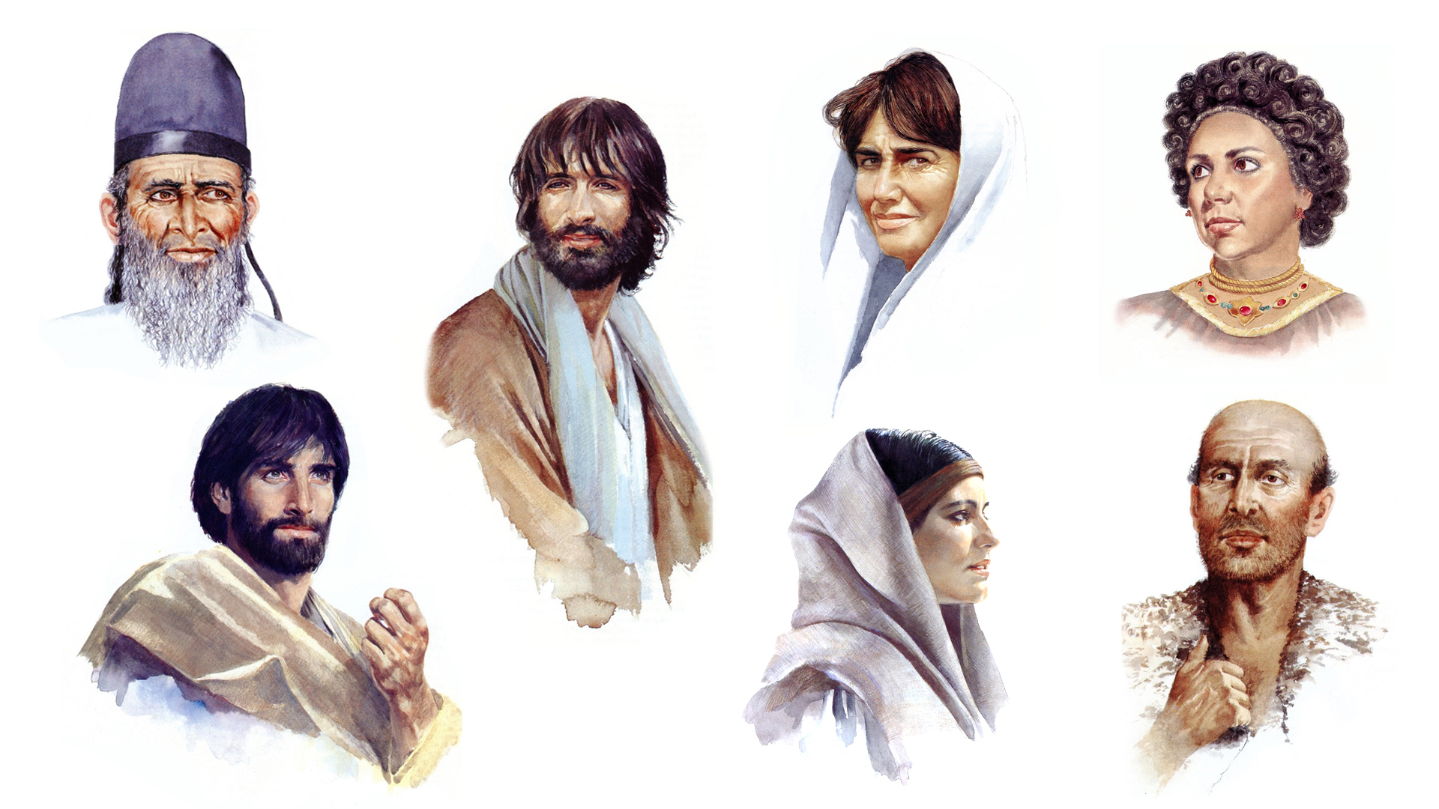
Barnabas
Dorcas
Philip
Lydia
Stephen
The Jailer
Rhoda

Slide 38
Timothy

Slide 39
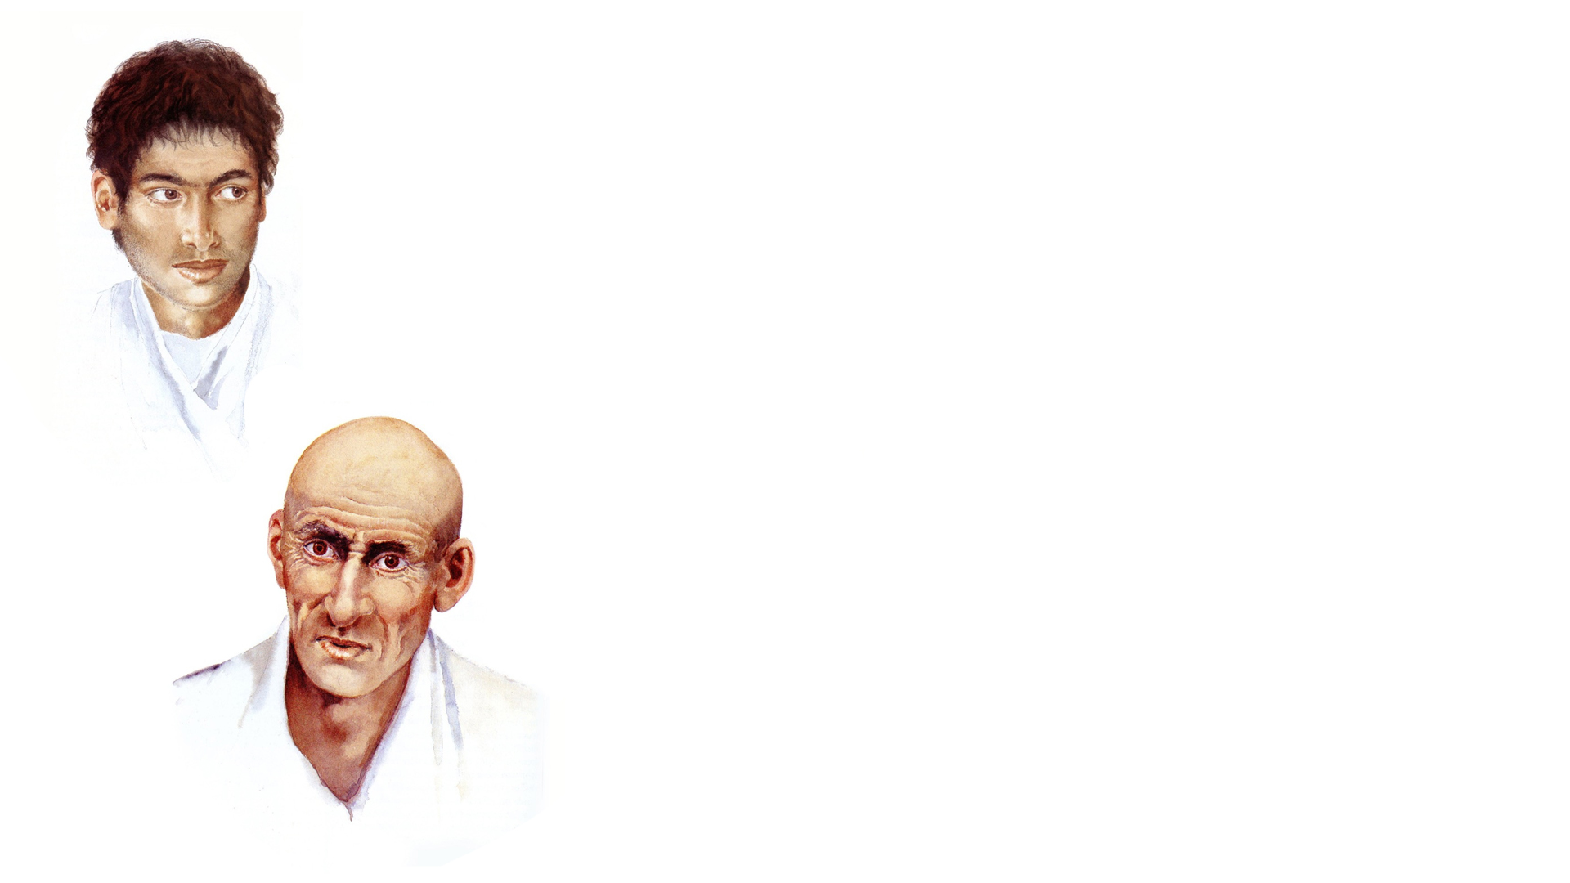
Timothy
Aeneas

Slide 40
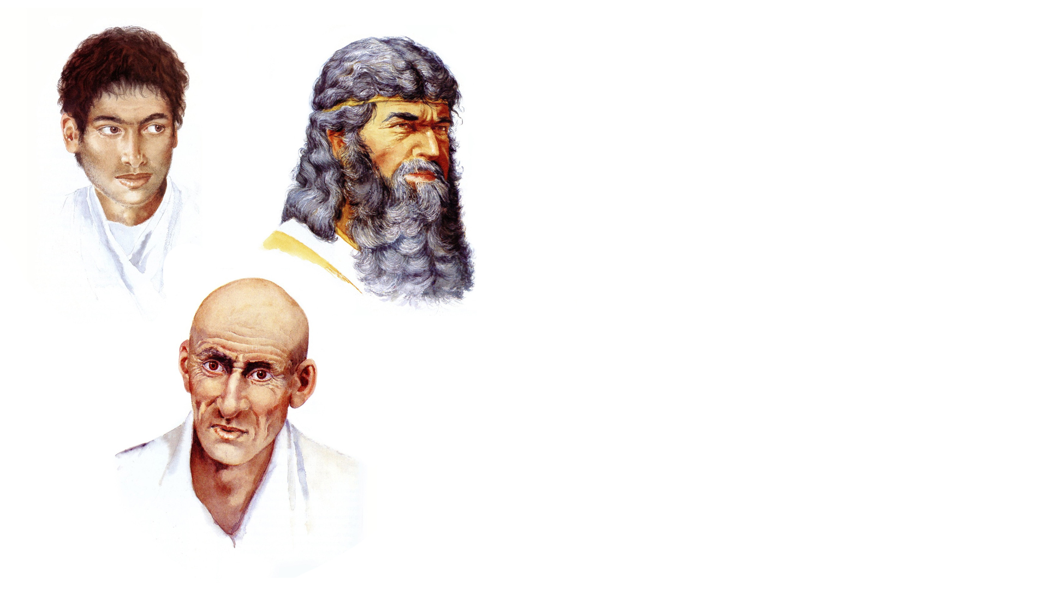
Timothy
Ananias
Aeneas

Slide 41
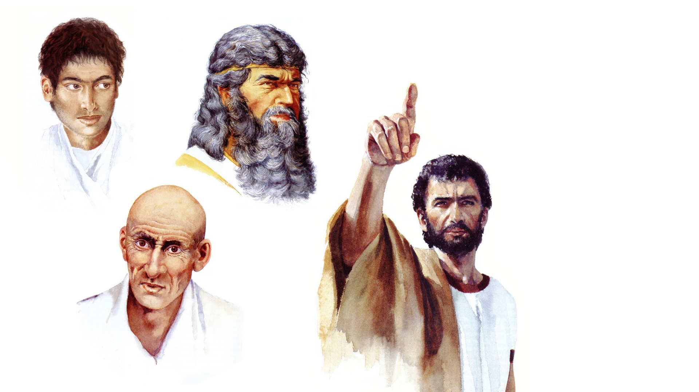
Timothy
Ananias
Aeneas
Saul

Slide 42
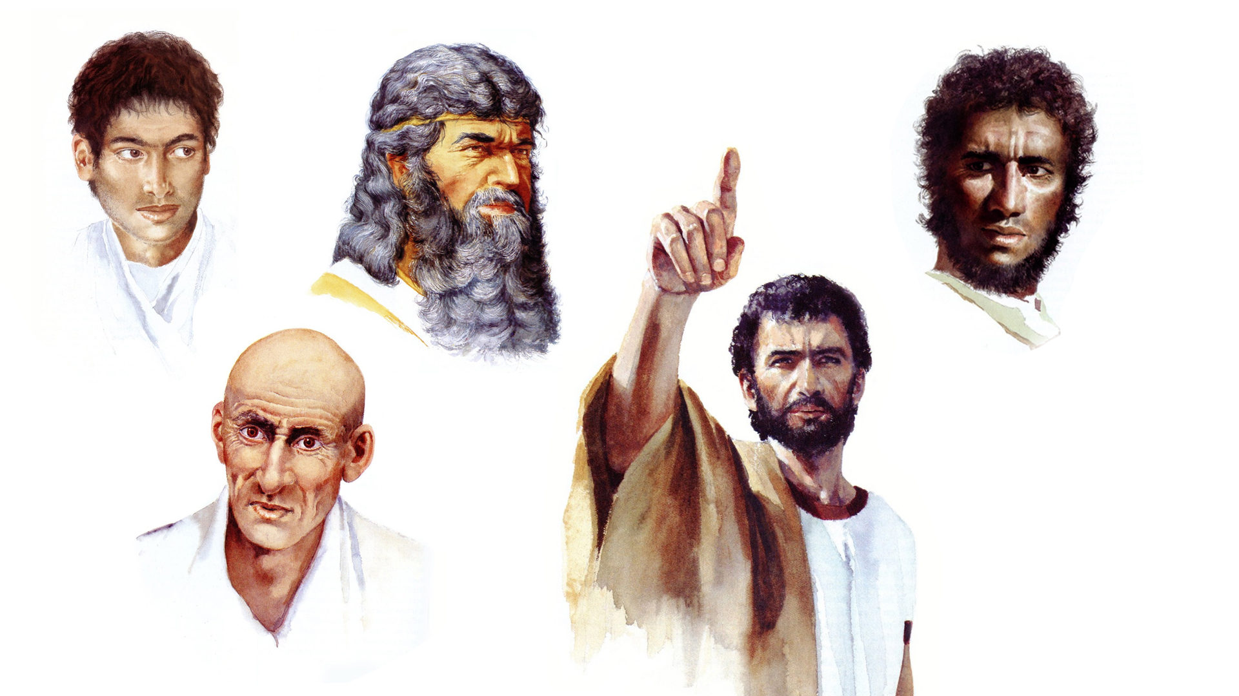
Timothy
Ethiopian Eunuch
Ananias
Aeneas
Saul

Slide 43
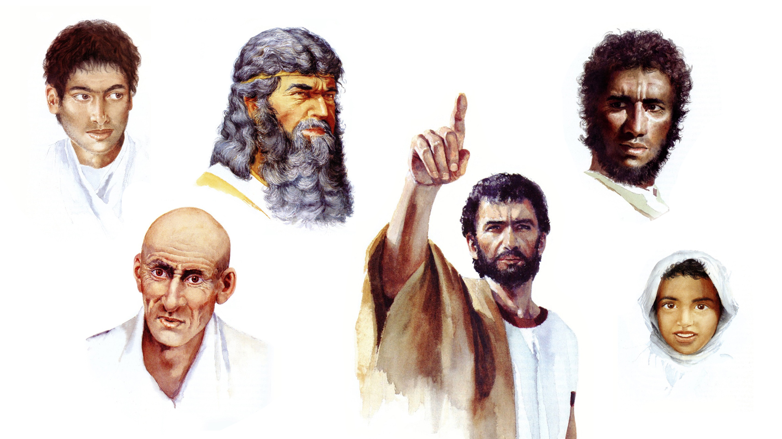
Timothy
Ethiopian Eunuch
Lydia
Ananias
Aeneas
Saul
Eutychus

Slide 44
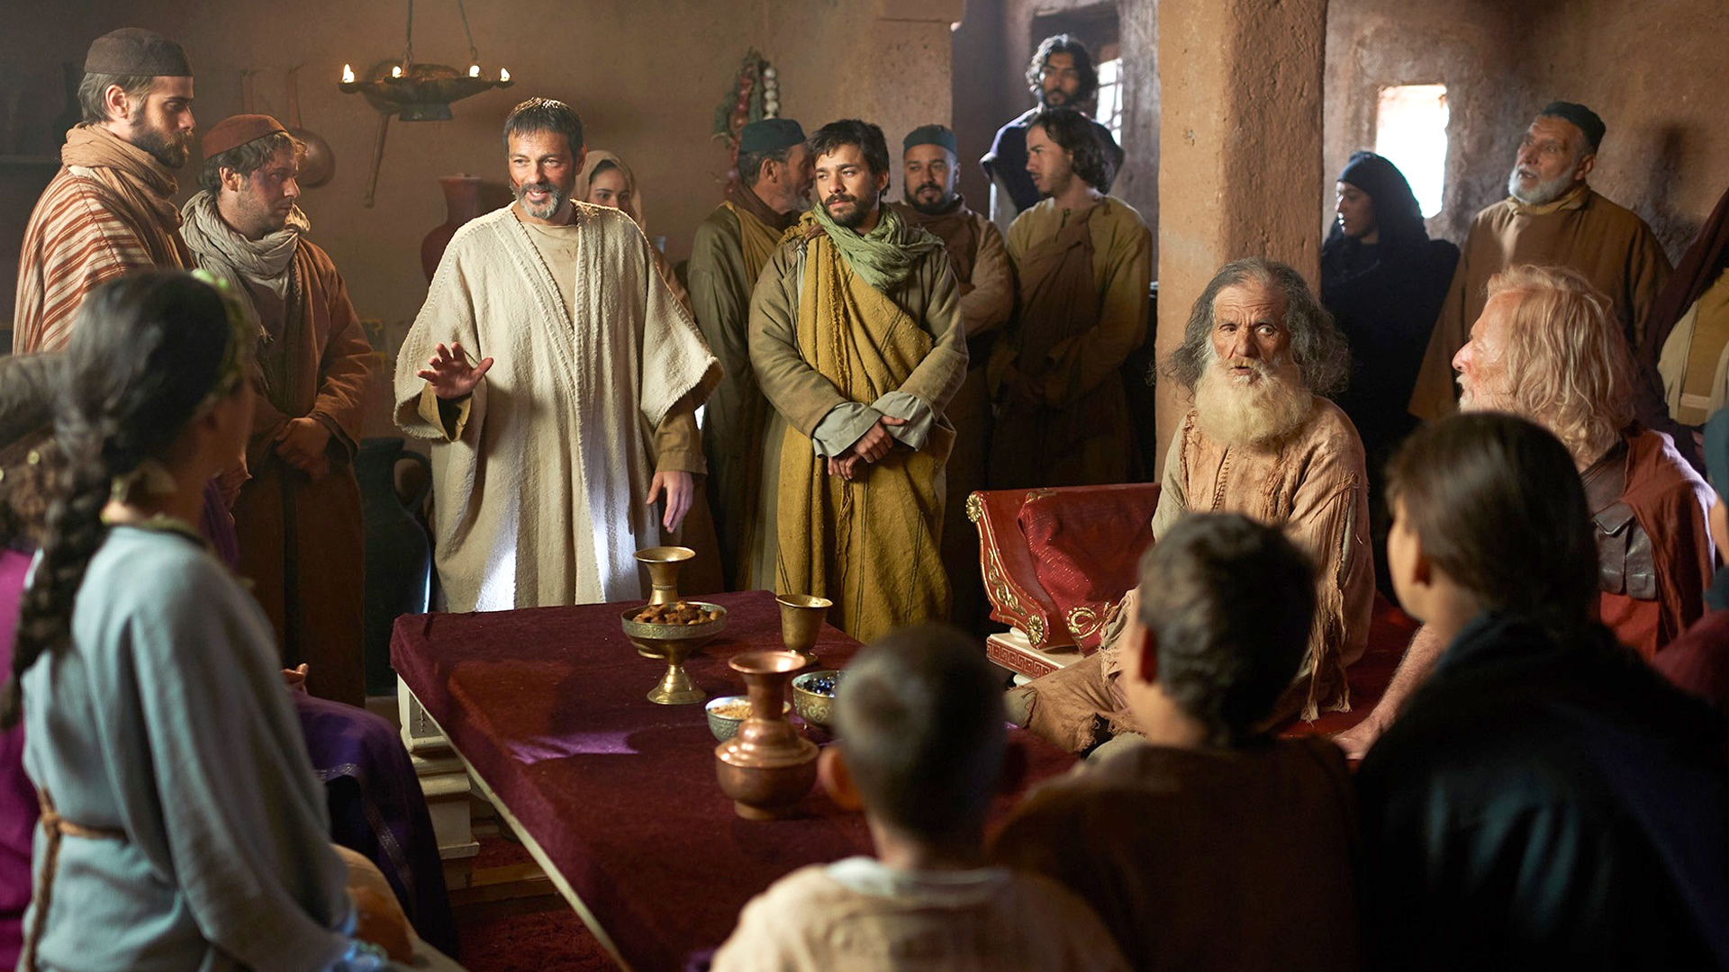

Slide 45
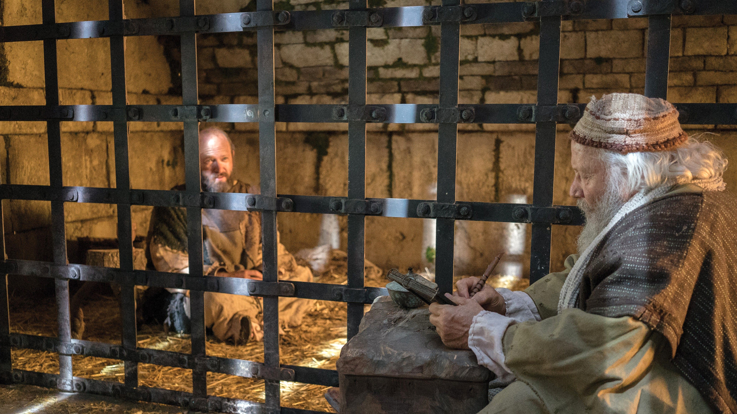

Slide 46
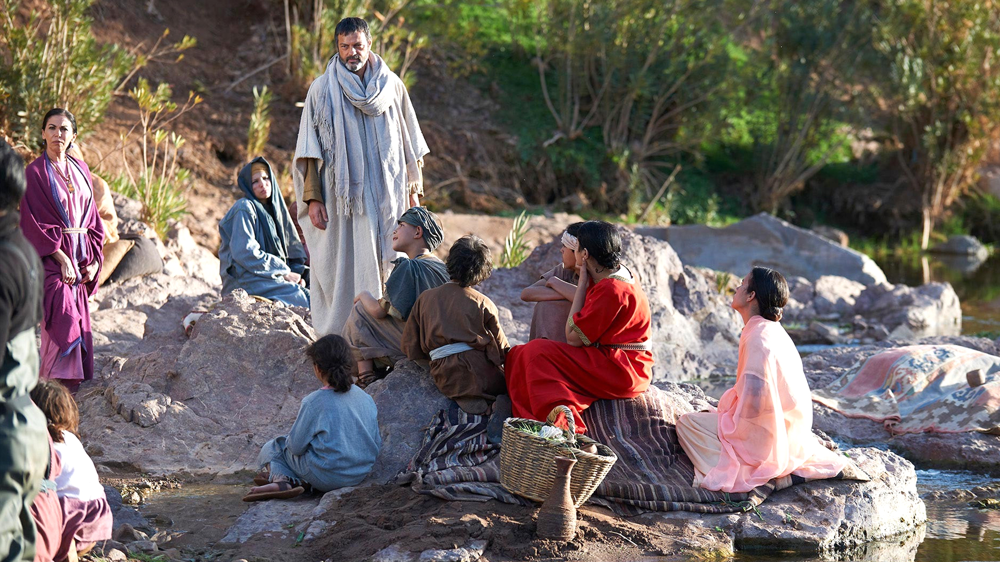

Slide 47
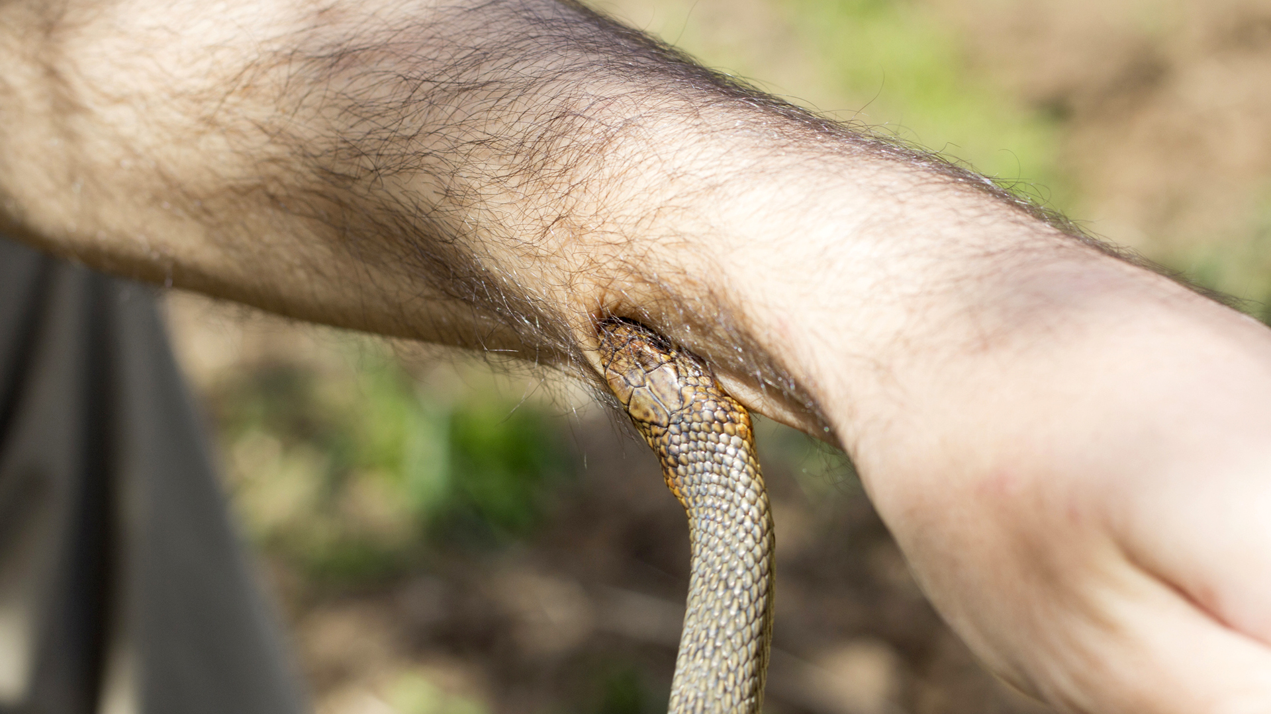

Slide 48
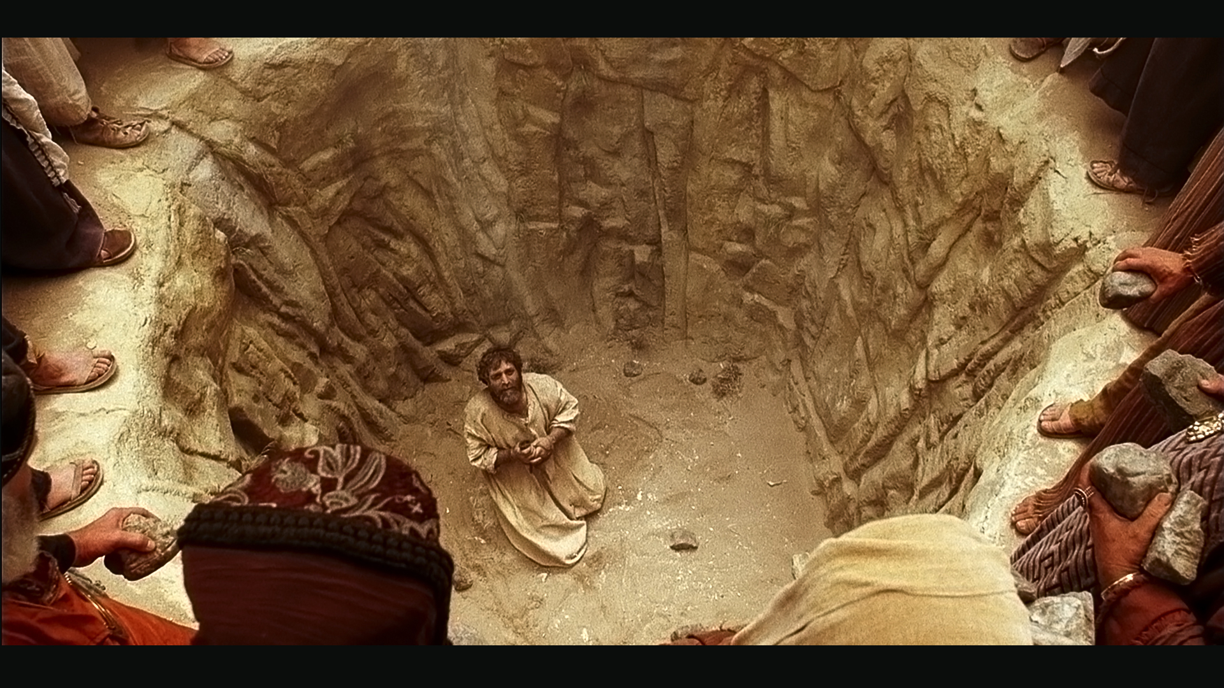

Slide 49
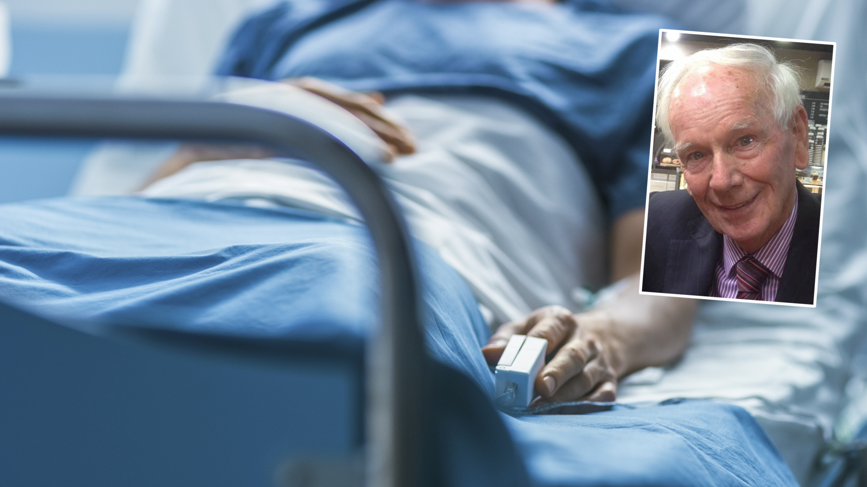

Slide 50
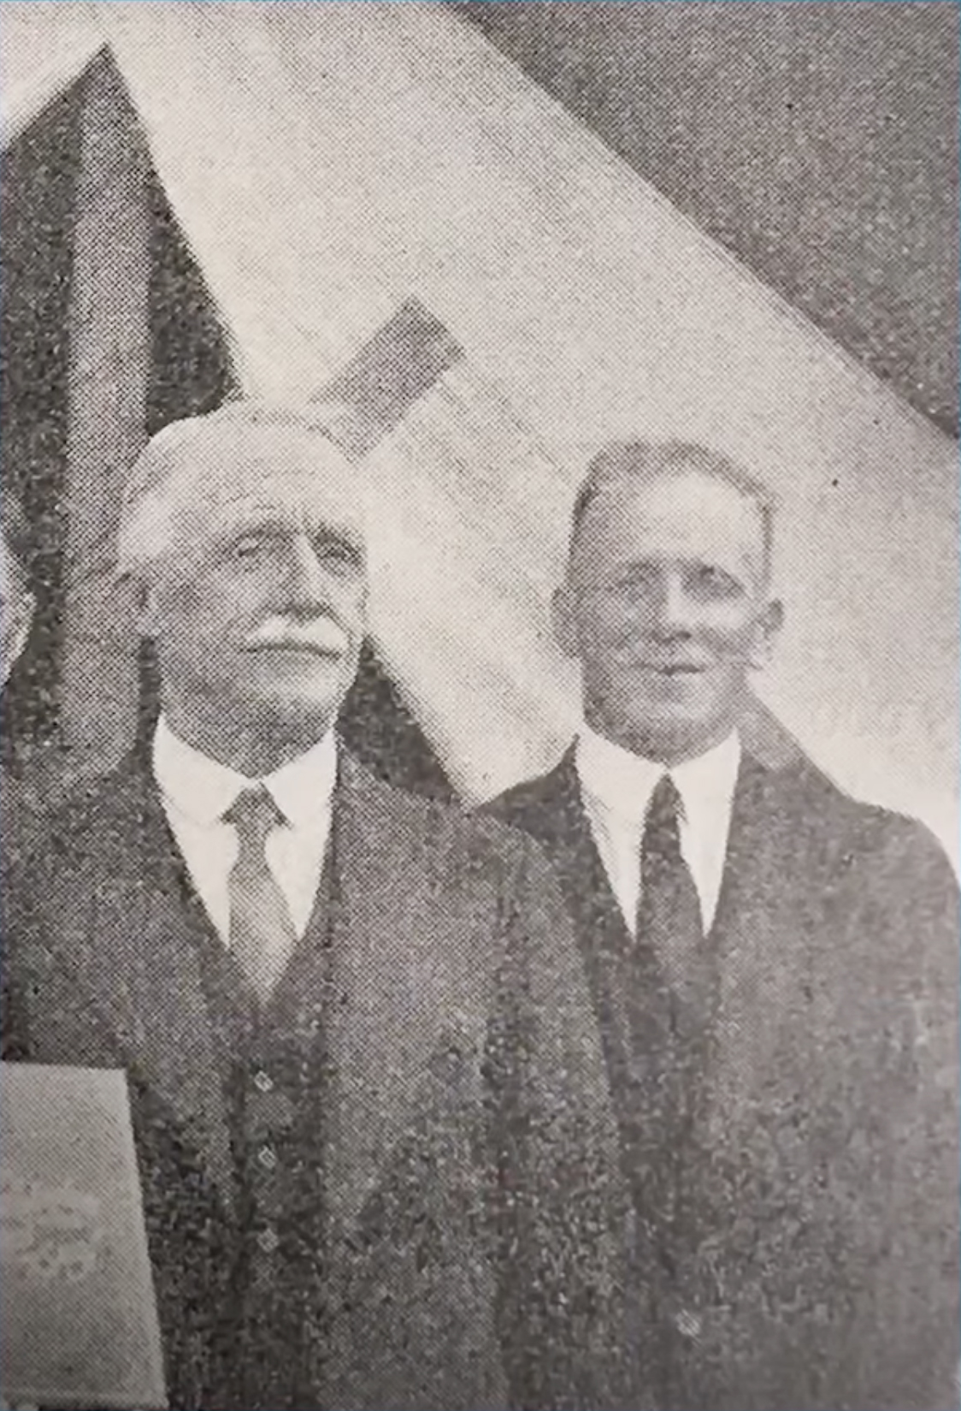
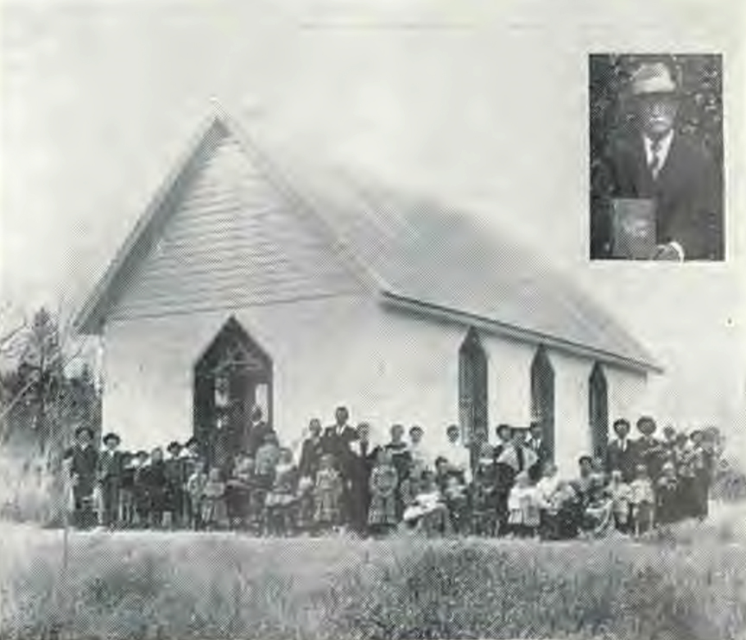

Slide 51
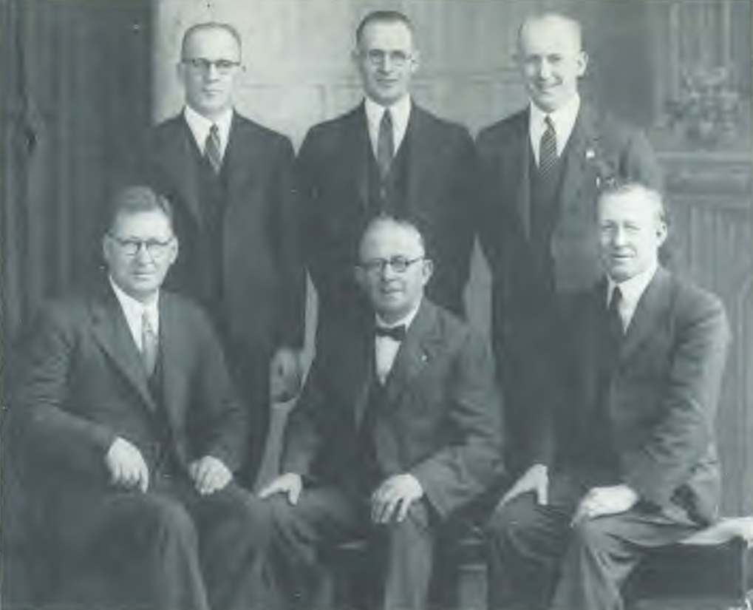
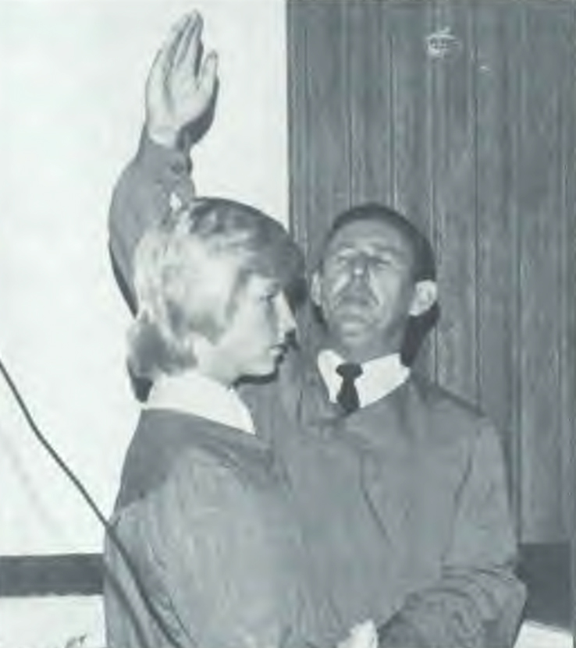

Slide 52
