Slide 1

Джонас Арраис
Июнь 2026

Slide 2
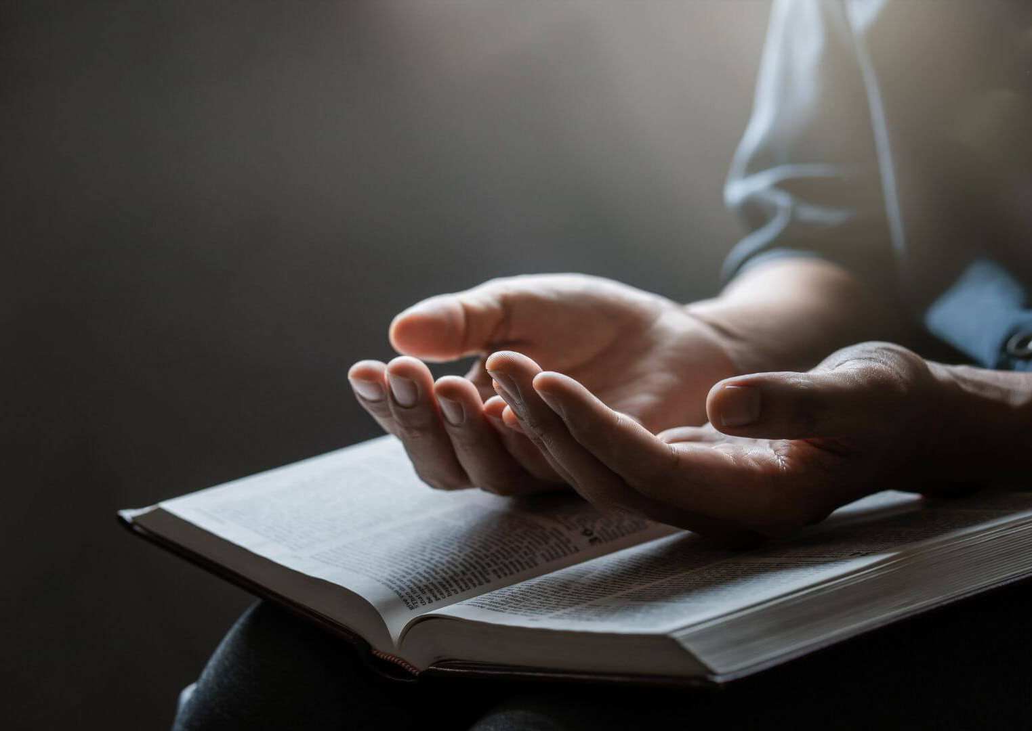
Быть пастором - все еще самое великое преимущество в жизни
Notes:
Being a pastor is a great privilege because we serve, teach, and witness God's work in the lives of others.
Pastors are entrusted with the responsibility of shepherding God's flock, equipping the saints, and proclaiming the gospel.

Slide 3
1. Погружен в Слово Божье
Notes:
Pastors have the extraordinary opportunity to spend their lives studying, sharing, and teaching God's Word.

Slide 4
2. Ведет людей ко Христу
Notes:
We have a great privilege to influence people and lead them to Jesus Christ.
This includes witnessing conversions, seeing marriages restored, and offering comfort during times of loss.

Slide 5
3. Служит другим
Notes:
We are call to serve. Pastors are called to dedicate their lives to serving others, helping them grow in faith, and navigating the complexities of life.
They offer support, encouragement, and guidance, helping people apply biblical principles to their daily lives

Slide 6
4. Участвует в исторических моментах жизни членов церкви
Notes:
Birthday celebrations, wedding ceremonies, graduations, funeral services…

Slide 7
5. Посещает членов церкви
Notes:
This is one of the greatest joys in my ministry. Incarnational ministry. Ministry of love.

Slide 8
6. Завязывает отношения и дружбу
Notes:
Pastors build deep and meaningful relationships with their congregations, experiencing the joys and sorrows of their lives.
This involves both celebrating with them in times of joy and offering comfort and support during times of hardship.
While the role of a pastor is a privilege, it also comes with significant responsibility and can be demanding. However, the rewards are many.
Be proud to be a pastor called by God and be the best pastor to God's people.

Slide 9
7. Получает признание и высокую оценку со стороны членов церкви
Notes:
At the church door. Gifts when we celebrate birthday or lead a week of prayer.

Slide 10
8. Работа и финансовая стабильность
Notes:
We don’t receive a big salary, but we live with dignity and financial stability.

Slide 11
9. Вечная значимость
Notes:
Our ministry has eternal impact and results in the life of people.

Slide 12
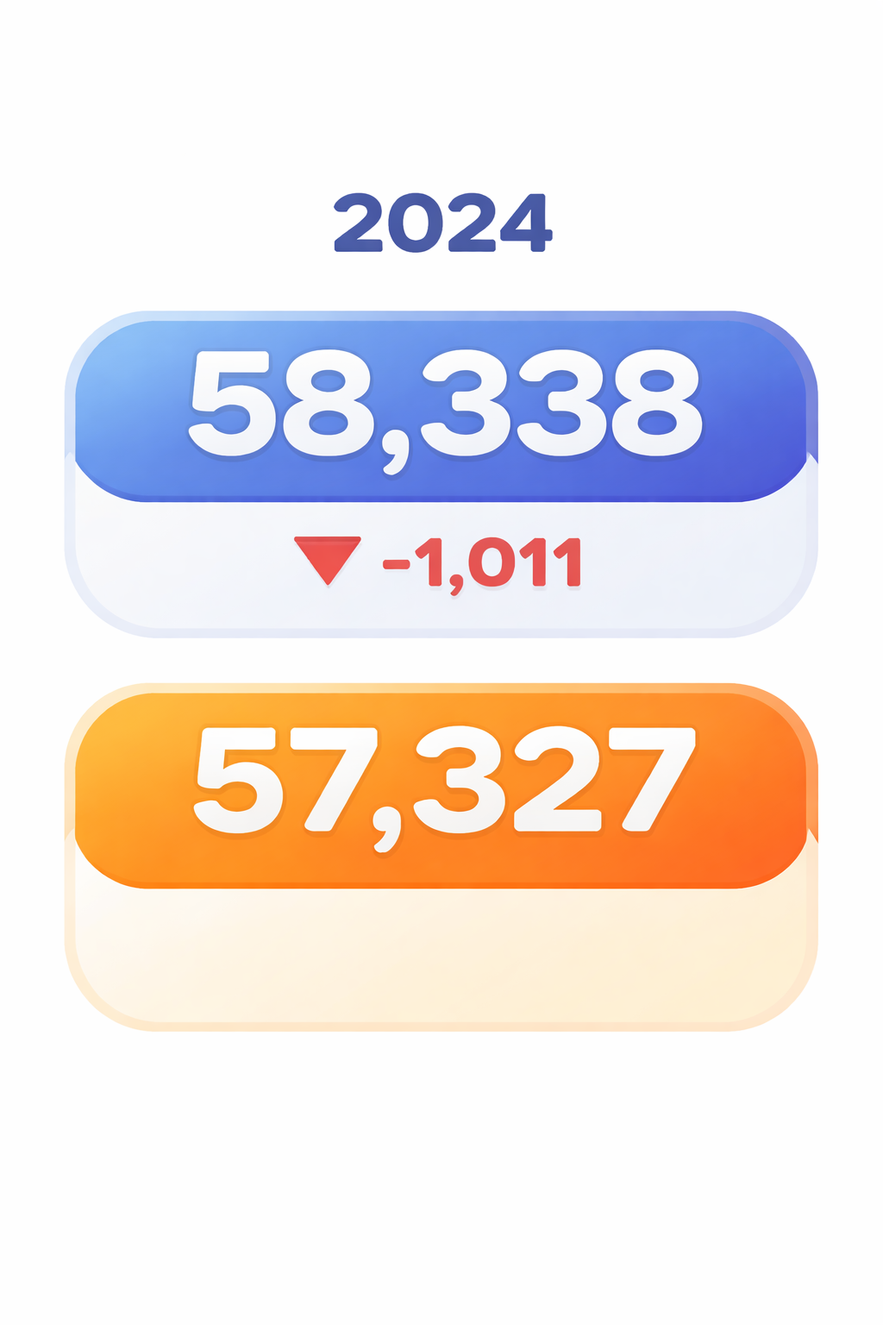
Notes:
GC 2025 Annual Statistical Report
Church membership at beginning of the year 2024: 58,338
Church membership at the end of the year 2024: 57,327

Slide 13
58,338 членов церкви по спискам
31,250 посещают церковь

Slide 14
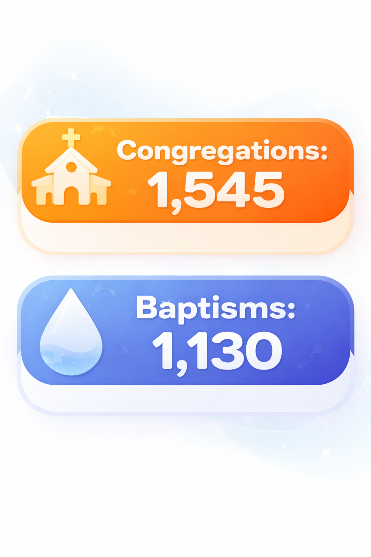
Общин:
Крещений:

Slide 15
Члены церкви, которые отсутствуют

Slide 16
Секуляризм
Notes:
Secularism is a way of living without God, without a relationship with Him.
It is possible to be a church member and still not have a real relationship with Jesus. A secular church cannot grow spiritually.

Slide 17
Законничество
Notes:
Legalism happens when people try to earn salvation through rules, traditions, or religious activities. In the legalism people (Christians) use the law, the Bible, Bible verses for a purpose that is not there.

Slide 18
Формализм
Notes:
Religious formalism is expressed when we try to do everything in the same way, mechanically, automatically, repetitions without to understand the meaning of what is being doing.
Most of the churches are singing the same songs, having the same liturgy, focusing in the appearance.

Slide 19
Традиционализм
Notes:
We have many good traditions in our church. We should value and preserve them. You have heard this expression: “This is the way we have always done it.” Traditions are unhealthy when people are not open for adaptations, improvement, changes for better.

Slide 20
Деноминационализм
Notes:
Sometimes we become so focused on maintaining the church organization and structure that we forget the church's purpose.

Slide 21
Что вы возьмете с этой встречи, чтобы сделать свое служение более актуальным и эффективным?

Slide 22
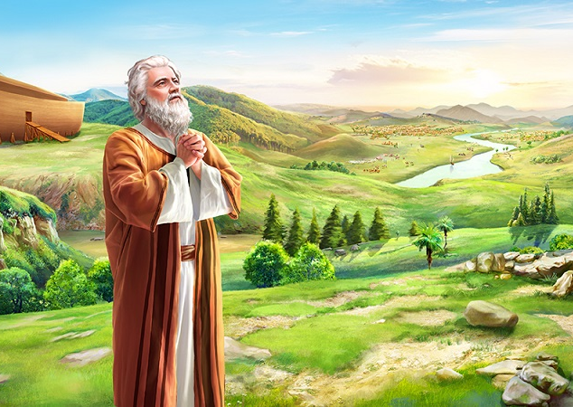
Образец для духовных лидеров

Slide 23
“Ной же обрел благодать пред очами Господа.”
Бытие 6:8

Slide 24
ВЕРА НОЯ БЫЛА ВИДИМОЙ

Slide 25
“Ной был человек праведный и непорочный в роде своем.”
Бытие 6:9

Slide 26
Где в жизни проявляются ваши представления о Боге и Библии?

Slide 27
“на Моисеевом седалище сели книжники и фарисеи, итак, все, что они велят вам соблюдать, соблюдайте и делайте; по делам же их не поступайте, ибо они говорят, и не делают.”
Мф. 23:2-3

Slide 28
БОГ ПРОСИТ НОЯ СДЕЛАТЬ НЕЧТО, ЧЕГО ОН НИКОГДА РАНЬШЕ НЕ ДЕЛАЛ
Бытие 6:14

Slide 29
Будьте готовы делать нечто новое

Slide 30
ОБЪЯВЛЯЙТЕ И ЖДИТЕ ЧЕГО-ТО ТАКОГО, ЧЕГО НИКОГДА НЕ СЛУЧАЛОСЬ

